Slide 1
Dreamweaver Domain 6: Evaluating and Maintaining a Site by Using Dreamweaver CS5
Adobe Creative Suite 5
ACA Certification Preparation:
Featuring Dreamweaver, Flash, and Photoshop
1
1

Slide 2
Objectives
Conduct technical tests.
Identify techniques for basic usability tests.
Identify methods for collecting site feedback.
Present web pages to others (such as team members and clients) for feedback and evaluation.
Manage assets, links, and files for a site.
Publish and update site files to a remote server.
2
2

Slide 3
Vocabulary
Get
orphaned files
publishing
Put
3
3

Slide 4
Domain 6.0 Evaluating and Maintaining a Site by Using Dreamweaver CS5
The final domain focuses on evaluating and maintaining a website.
4
4

Slide 5
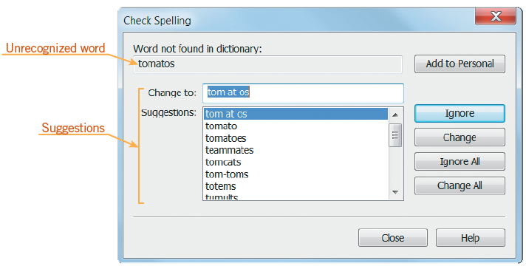
Objective 6.1 Conduct Technical Tests
One of the first steps in preparing your website for publication is to check the spelling.
When Dreamweaver finds an unrecognized word from the selected dictionary, the Check Spelling dialog box opens.
5
5

Slide 6
Objective 6.1 Conduct Technical Tests (continued)
Before publishing a website, it is important to verify that links work properly.
Dreamweaver provides three different levels for checking links: in the current document, portions of a local site, or across the entire site.
6
6

Slide 7
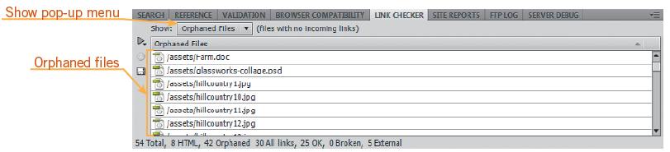
Objective 6.1 Conduct Technical Tests (continued)
When you check links in the current document or site, the Link Checker panel opens, above or below the Property inspector.
7
7

Slide 8
Objective 6.1 Conduct Technical Tests (continued)
Orphaned files are files that exist in the site, but are not linked to any other file.
Design view provides an idea of how your page will look on the web, but does not depict the page exactly. Live view gives you a more accurate interpretation, while allowing you to also work in Code view when needed.
8
8

Slide 9
Objective 6.1 Conduct Technical Tests (continued)
To view the pages in specific browsers that are installed on your computer, or Device Central or Adobe BrowserLab, click File on the Application bar (Win) or Menu bar (Mac), point to Preview in Browser, and then click a preview option.
To preview pages in a variety of browsers and versions not installed on your computer, you can use Adobe BrowserLab.
9
9

Slide 10
Objective 6.1 Conduct Technical Tests (continued)
Refer to your wireframe and storyboard that you created during the planning stage to review your plans. You perform this part of the quality assurance testing to ensure that you have met the requirements that were determined by you and your client.
10
10

Slide 11
Objective 6.2 Identify Techniques for Basic Usability Tests
You can perform a usability test to verify how well your site functions among different users.
Develop a checklist or script before testing to determine what you want to measure.
Assemble a diverse group of participants to review your website against the checklist and determine the usability of your site.
Usability.gov provides a guide to assist in the process.
11
11

Slide 12
Objective 6.3 Identify Methods for Collecting Site Feedback
Once your website is published, you may choose to receive feedback from actual visitors to your site.
This can be done by asking the user to complete a survey before they leave the site.
You can also create an e-mail link for those visitors who wish to leave a comment about your site.
12
12

Slide 13
Objective 6.3 Identify Methods for Collecting Site Feedback (continued)
You can also gather site feedback without visitors knowing it. Services are available to proactively monitor your website to report on broken links and digital assets that may not be tagged correctly.
Services are available to track and analyze how visitors are getting to, using, and navigating your site.
13
13

Slide 14
Objective 6.4 Present Web Pages to Others for Feedback and Evaluation
You can assemble focus groups to help you determine how visitors feel and think when they visit your site.
Focus groups can be used before a website is published, after implementation, or when planning a redesign.
Before assembling the focus group, it is important to identify the target audience. Next, identify specific goals and objectives.
Have a moderator present to make sure conversations remain on topic.
14
14

Slide 15
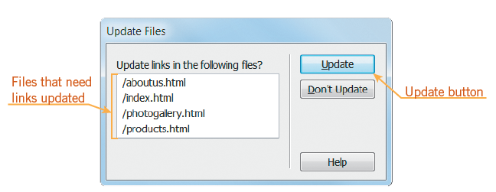
Objective 6.5 Manage Assets, Links, and Files for a Site
You can set up the Files panel for not only managing your assets locally, but also to publish them to a remote or testing server.
Files can be deleted, renamed, or moved in the Files panel.
When you rename a file, Dreamweaver prompts you to update any links that are associated with that file.
15
15

Slide 16
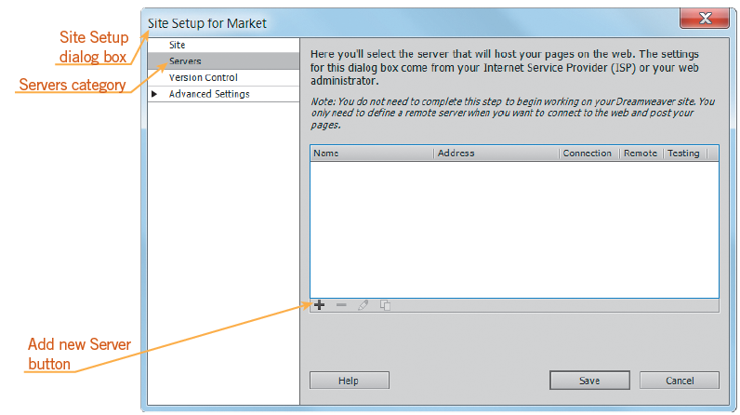
Objective 6.6 Publish and Update Site Files to a Remote Server
When you want Dreamweaver to connect to a remote folder, you specify the remote folder in the Server category of the Site Definition dialog box.
16
16

Slide 17
Objective 6.6 Publish and Update Site Files to a Remote Server (continued)
When a remote connection is first established, the remote folder is usually empty.
Uploading the files in your local root folder to the remote folder populates the remote folder and is called publishing.
The directory structure of both these folders should always be the same.
You use the Put command to publish your files to the remote folder.
17
17

Slide 18
Objective 6.6 Publish and Update Site Files to a Remote Server (continued)
You use the Get command to download files from the remote folder to the local root folder.
To ensure that more than one person does not work on a file at the same time, use the Check Out command.
If you are working on a file by using the Check Out command, the file needs to be placed back in the remote folder with the Check In command.
18
18

Slide 19
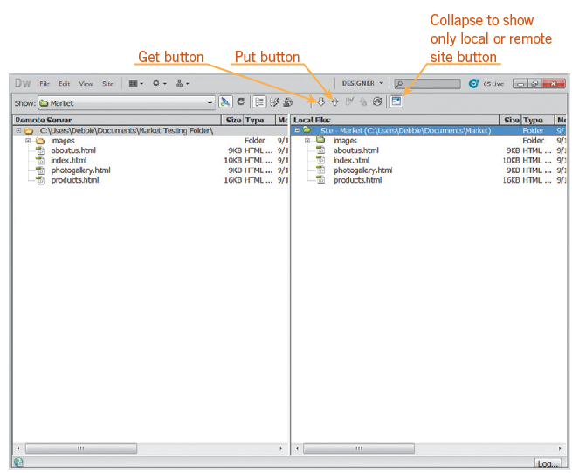
Objective 6.6 Publish and Update Site Files to a Remote Server (continued)
To view panes displaying the remote server folder and local site folder, click the Expand to show local and remote site button on the Files panel.
19
19

Slide 20
Summary
Objective 6.1 Conduct Technical Tests
Objective 6.2 Identify Techniques for Basic Usability Tests
Objective 6.3 Identify Methods for Collecting Site Feedback
Objective 6.4 Present Web Pages to Others for Feedback and Evaluation
Objective 6.5 Manage Assets, Links, and Files for a site
20
20

Slide 21
Summary (continued)
Objective 6.6 Publish and Update Site Files to a Remote Server
21
21

